Slide 1

Automotive Technology:
A Systems Approach, 8e
Chapter 2: Workplace Skills
Rob Thompson and Jack Erjavec, Automotive Technology: A Systems Approach, 8th Edition. © 2025 Cengage. All Rights Reserved. May not be scanned, copied or duplicated, or posted to a publicly accessible website, in whole or in part.

Slide 2
Chapter Objectives (1 of 2)
02.01 Seek and apply for employment.
02.02 Prepare a resume and cover letter.
02.03 Prepare for an employment interview.
02.04 Accept employment.
02.05 Explain how automotive technicians are compensated.
02.06 Describe the proper relationship between an employer and an employee.

Slide 3
Chapter Objectives (2 of 2)
02.07 Describe the key elements of on-the-job communications.
02.08 Explain why technicians need critical thinking and problem-solving skills.
02.09 Discuss the professional appearance and behavior of automotive technicians.
02.10 Discuss how fellow workers and customers should be treated.

Slide 4
Seeking and Applying for Employment
Getting a job, especially in a professional field like automotive service, involves many steps.
As with many things in life, you must be adequately prepared before taking the next step toward employment.
This discussion suggests ways you can prepare and what to expect while taking these steps.

Slide 5
Employment Plan
An employment plan is nothing more than an honest appraisal of yourself and your career hopes.
The plan should include your employment goals, a timetable for reaching those goals, and a prioritized list of potential employers or types of employers.
Think about the type of job you want and do some research to find out what is required to get that job.
Evaluate yourself against those requirements.
If you do not meet the requirements, set up a plan for obtaining the needed skills.

Slide 6
Self-Appraisal
To begin the self-appraisal part of your employment plan, ask yourself:
  Why am I looking for a job?
  What specifically do I hope to gain by having a job?
  What do I like to do?
  What am I good at?
  What skills do I currently have that would make me employable?
  Which of my skills would I like to use in my job?
  What skills should I add or improve to get the job I want?

Slide 7
Identifying Your Skills (1 of 2)
Honestly evaluate yourself to determine what skills you have:
  Using a computer
  Working with tools, machines, or equipment
  Doing math problems
  Maintaining or fixing things
  Figuring out how things work
  Making things with your hands
  Working with ideas and information
  Solving puzzles or problems
  Studying or reading
  Doing experiments or researching a topic
  Expressing yourself through writing

Slide 8
Identifying Your Skills (2 of 2)
Personal skills are also called soft skills and are things that are part of your personality. These are things you are good at or enjoy doing, such as:
  Working with people
  Caring for or helping people
  Working as a member of a team and independently
  Leading or supervising others
  Following orders or instructions
  Persuading people or negotiating with others

Slide 9
Identifying Job Possibilities (1 of 2)
Your task is to identify the companies that are hiring. There are many ways of doing this, including the following:
  Checking your school’s job posting board or make an appointment with a placement coordinator
  Attending a job fair
  Searching job websites, such as LinkedIn, Glassdoor,
  Monster, Indeed, and Job Corps
  Checking the employment web pages of local businesses for job openings

Slide 10
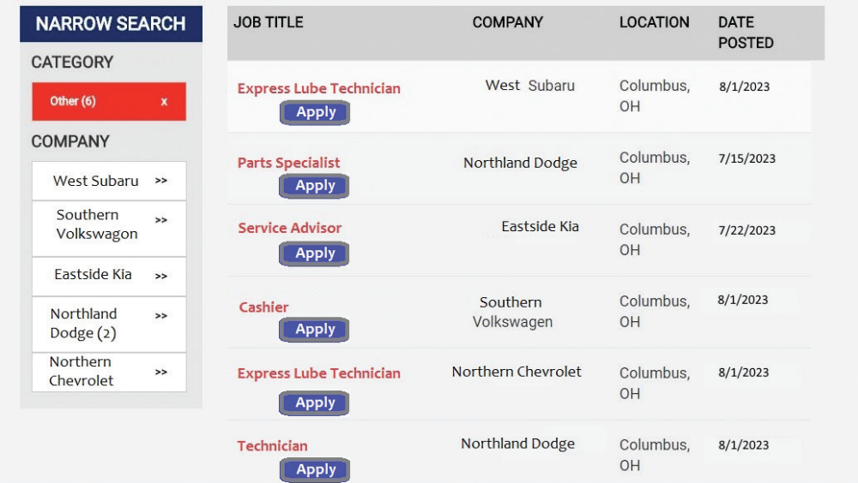
Identifying Job Possibilities (2 of 2)
02.01 Seek and apply for employment.
Checking the employment web pages of local businesses for job openings shown:

Slide 11
Preparing Your Resume (1 of 2)
Your resume and cover letter are your own personal marketing tools and may create your first impression on an employer.
A resume should include:
  Your contact information
  Career objective
  Skills and/or accomplishments
  Work experience
  Education
  A statement about references.

Slide 12
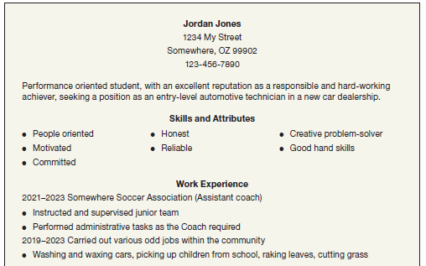
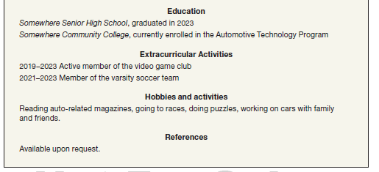
Preparing Your Resume (2 of 2)
Sample resume shown:
02.02 Prepare a resume and cover letter.

Slide 13
Preparing Your Cover Letter (1 of 3)
A cover letter gives you a chance to point out exactly why you are perfect for the job.
You should not send out the same cover letter to all potential employers.
Adjust the letter to match the company and position you are applying for.
Yes, this means a little more work, but it will be worth it.

Slide 14
Preparing Your Cover Letter (2 of 3)
Guidelines for Writing an Effective Cover Letter: Follow these guidelines while preparing and writing your cover letter:
First paragraph
  Tell the employer you are interested in working for them
Second paragraph
  Sell yourself by addressing one or two of your qualifications
Third paragraph
  Thank the employer for taking the time to review your résumé

Slide 15
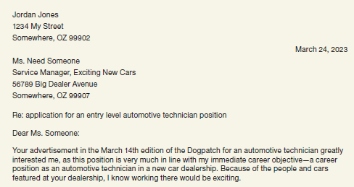
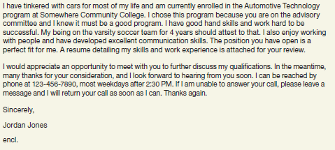
Preparing Your Cover Letter (3 of 3)
Sample cover letter shown:

Slide 16
Knowledge Check (1 of 2)
What is the purpose of the cover letter?

Slide 17
Knowledge Check Answer (1 of 2)
What is the purpose of the cover letter?
Answer: To let the employer know, in your own words, why you are perfect for the job.

Slide 18
The Interview
02.03 Prepare for an employment interview.
Typically, employers who are interested in you will contact you to come in for an interview.
Although an interview does not last very long, it is a time when you can either get the job or lose it.
Some common interview questions include:
  What can you tell me about yourself?
  What are your strengths and weaknesses?
  If we employ you, what will you do for us?
  Think of a time you encountered a problem at work or school. How did you solve it?

Slide 19
Accepting Employment
02.04 Accept employment.
When you accept the job, you are entering into an agreement with the employer.
That agreement needs to be honored.
Make sure you are ready to start working.
Typically before you begin to work, or at least before you get paid, you will fill out state and federal income tax forms.

Slide 20
Compensation
02.05 Explain how automotive technicians are compensated.
Automotive technicians can be paid in a number of ways including:
  Hourly Wages
  Commission
  Flat-Rate
The total amount of what you earn is called your gross pay. This is not your “take home” or net pay.

Slide 21
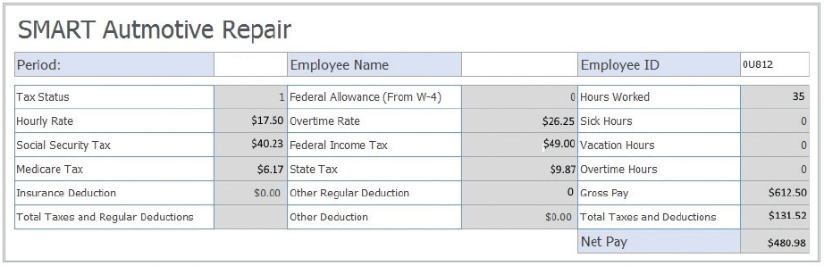
Hourly Wages Compensation
Most often, new or apprentice technicians are paid a fixed hourly wage for every hour they work

Slide 22
Commission Compensation
When technicians are paid on a commission basis, they receive a minimum hourly wage plus a percentage of what the shop receives for performing various services.
This pay system can work well for technicians who are employed in a shop whose business fluctuates through the year.

Slide 23
Flat-Rate Compensation (1 of 2)
Flat-rate is a pay system in which a technician is paid for the amount of work, meaning labor hours, they complete.
The flat-rate system favors technicians who work in a shop that has a large volume of work.
Every conceivable service to every different model of vehicle has a flat-rate time. These times are assigned by the automobile manufacturers.
Flat-rate times are listed in a labor guide, which can be a manual or be available on a computer.

Slide 24
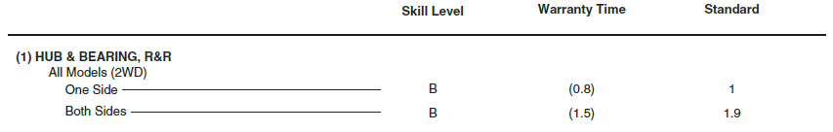
Flat-Rate Compensation (2 of 2)
As you can see, flat-rate times are broken down into tenths of an hour.
A job that pays for 3.1 hours means you will be paid for 3 hours and 6 minutes regardless of how long it took to complete the job.
The goal is to complete more than 8 hours of jobs in your 8 hour shift, which will increase your pay.

Slide 25
Knowledge Check (2 of 2)
If a flat-rate technician is clocked in for 8 hours, yet completes jobs totaling 12 hours in labor time, how many hours are they paid?

Slide 26
Knowledge Check Answer (2 of 2)
If a flat-rate technician is clocked in for 8 hours, yet completes jobs totaling 12 hours in labor times, how many hours are they paid?
Answer: They are paid 12 hours.

Slide 27
Working as a Technician (1 of 2)
02.06 Describe the proper relationship between an employer and an employee.
Once you have the job, you need to keep it.
Make sure you arrive at work on time. If you are going to be late or absent, call the employer as soon as you can.
Be cheerful and cooperative with those around you.
Do not spend time talking or texting when you should be working.
Find out what is expected of you and do your best to meet those expectations.

Slide 28
Working as a Technician (2 of 2)
You should be told what is expected of you.
An employer should provide a clean and safe work area as well as a place for personal cleanup.
You should be given a chance to succeed and possibly advance within the company.
A good employee is reliable.
As an employee, you are part of a team. Doing things your way may not serve the best interests of the company.

Slide 29
Communications
02.07 Describe the key elements of on-the-job communications.
Employers value employees who can communicate.
Effective communication includes listening, reading, speaking, and writing. Communication is a two-way process.
To be successful, you should carefully follow all oral and written directions that pertain to your job.
Nonverbal communication describes the things you do while communicating.
Proper telephone etiquette is also important.

Slide 30
Solving Problems and Critical Thinking (1 of 2)
02.08 Explain why technicians need critical thinking and problem-solving skills.
Anyone who can think critically and logically to evaluate situations is very desirable.
Critical thinking is the art of being able to judge or evaluate something without bias or prejudice.
Good critical thinkers begin solving problems by carefully observing what is and what is not happening.
Based on these observations, something is declared as a fact.

Slide 31
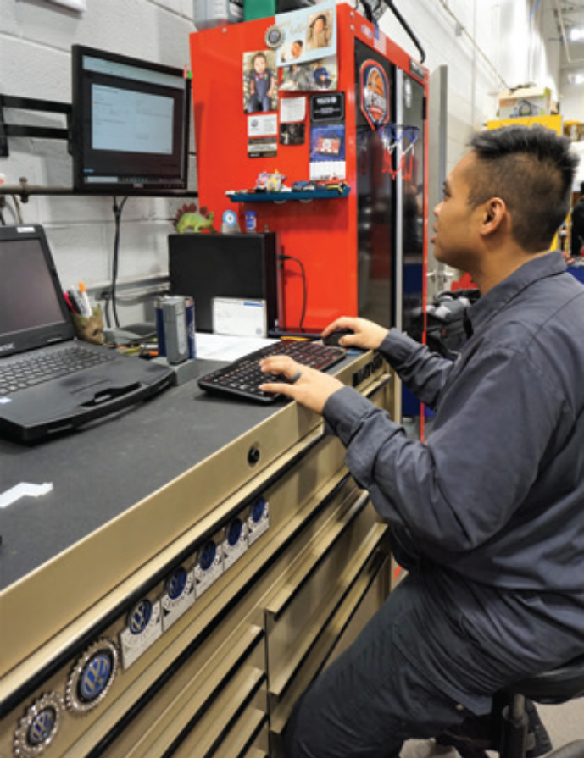
Solving Problems and Critical Thinking (2 of 2)
Critical thinking is especially important for performing diagnostic work.
For example, if the right headlamp of a vehicle does not light and the left headlamp does, a critical thinker will be quite sure that the source of the problem is related to the right headlamp and not the left one. Therefore, all testing will be centered on the right headlamp.
Inspection notes should be well documented in the business’ repair order system to keep track of vehicle service history and protect against potential liabilities.

Slide 32
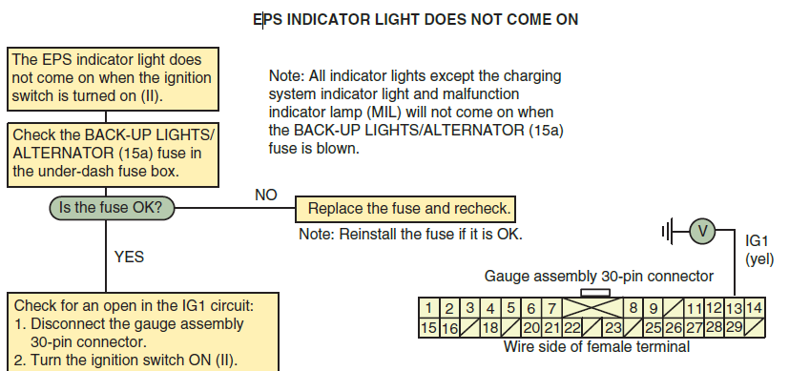
Diagnosis
Diagnosis is a way of looking at systems that are not functioning properly and finding out why. It is not guessing, and it is more than following a series of interrelated steps in order to find the solution to a specific problem.

Slide 33
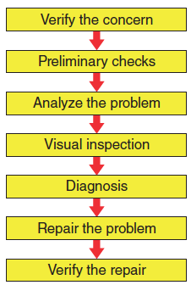
Diagnosis and Critical Thinking
When these diagnostic aids are not available or prove to be ineffective, good technicians conduct a visual inspection and then take a logical approach to finding the cause of the problem.
This relies on critical thinking skills as well as system knowledge. Logical diagnosis follows these steps:

Slide 34
Professionalism (1 of 2)
02.09 Discuss the professional appearance and behavior of automotive technicians.
A good technician is a highly skilled and knowledgeable individual.
A professional demonstrates the following:
  Self-esteem, pride, and confidence
  Honesty, integrity, and personal ethics
  A positive attitude toward learning, growth, and personal health.
  Respect for others
  The ability to set goals and priorities in work and personal life

Slide 35
Professionalism (2 of 2)
Additionally a professional technician should demonstrate:
  Assuming responsibility and accountability for decisions and actions.
  The willingness to follow rules, regulations, and policies.
  The willingness to fulfill the responsibilities of your job.
  The desire to learn something new every day, whether by reading a magazine or a book, watching a video, or even watching a car-related TV show.

Slide 36
Discussion Question
Have a class discussion about the behavior of automotive technicians.
Does anyone have examples of someone who is doing well in this area? Someone who already looks and acts the part of an automotive technician?
Think critically about whether or not you have areas in need of improvement relating to the appearance and behavior.

Slide 37
Interpersonal Relationships
02.10 Discuss how fellow workers and customers should be treated.
As an employee, you have responsibilities to your fellow workers:
  Suggest improvements that may make the business.
  Work with team members to achieve common goals.
  Exercise “give and take” for the benefit of the business.
  Respond to praise or criticism in a professional way.
  Provide constructive praise or criticism.
  Resolve conflicts in a professional way.

Slide 38

Customer Relations (1 of 2)
Good customer relations are important for all members of the team.
Present yourself as a professional. Professionals are proud of what they do and they show it.
Always dress and act appropriately and watch your language, even when you think no one is nearby.

Slide 39
Customer Relations (2 of 2)
Respect the vehicles you are working on. They are important to your customers.
Always return the vehicles to their owners clean and in an undamaged condition.
Remember, a vehicle is the second largest expense a customer has. Treat it that way.
It does not matter if you like the vehicle. It belongs to the customer; treat it respectfully.
Explain the repair process to the customer in understandable terms.
Whenever you are explaining something to a customer, make sure you do it in a simple way without making the customer feel unknowledgeable.

Slide 40
Chapter Reflection
Please take a moment to compare your perception of the automotive industry before and after you studied this chapter. Then respond to the following questions in one or two paragraphs. Use 150–200 words in your reflection.
Did anything in this chapter change your thinking about automotive careers? Describe what you learned and how it changed your ideas.
Considering all you have learned, do you feel you have the workplace skills to be an automotive technician? Why or why not?

